Slide 1
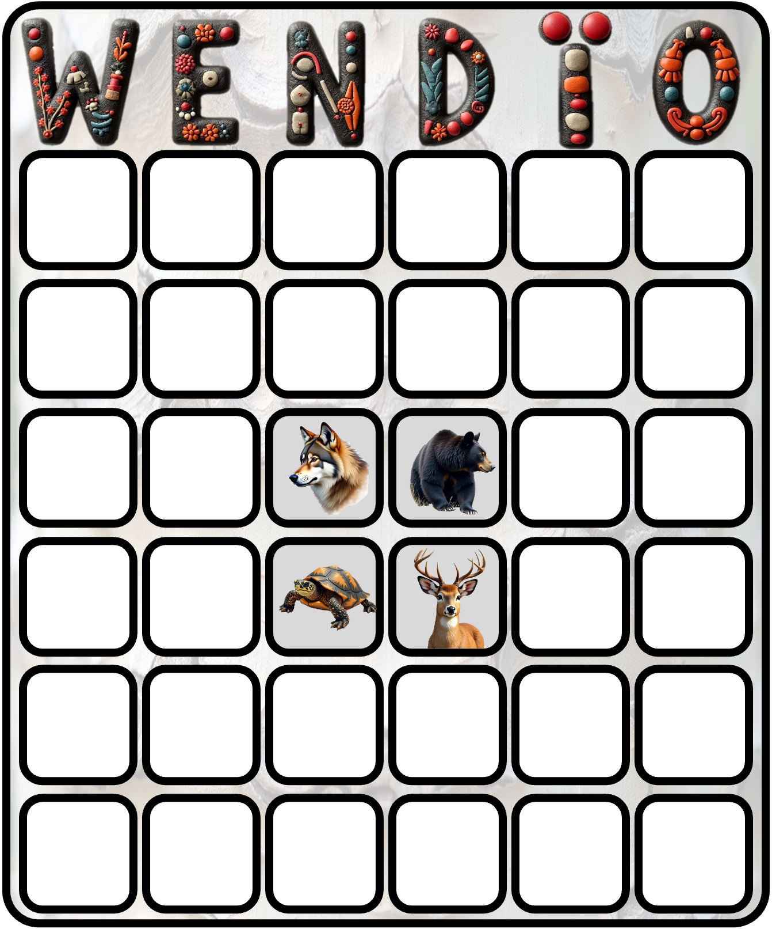
W | E | N | D | A | O
1 | 19 | 36 | 47 | 51 | 70
9 | 14 | 28 | 40 | 58 | 64
5 | 23 | 🐢 | 🐻 | 54 | 61
8 | 18 | 🐺 | 🦌 | 60 | 68
3 | 21 | 32 | 43 | 50 | 72
11 | 15 | 25 | 46 | 57 | 65
1
9
5
8
3
11
W | E | N | D | A | O
11 | 18 | 33 | 43 | 57 | 65
5 | 21 | 25 | 48 | 50 | 72
1 | 15 | 🐢 | 🐻 | 51 | 64
3 | 19 | 🐺 | 🦌 | 54 | 70
9 | 23 | 28 | 40 | 60 | 61
8 | 14 | 36 | 46 | 58 | 68

